Slide 1



SMO Framework Development
TEEP 2024 - Research Plan
Presented by:
Rafli Hadiana
Telkom University Student

Slide 2
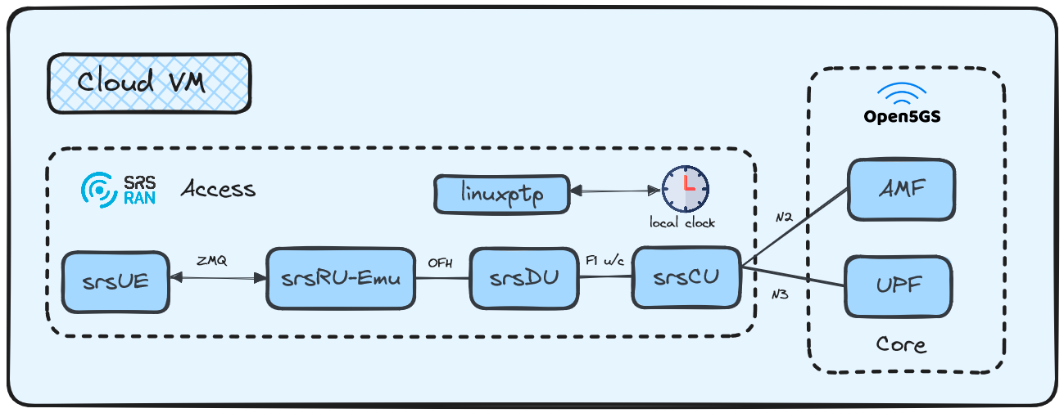
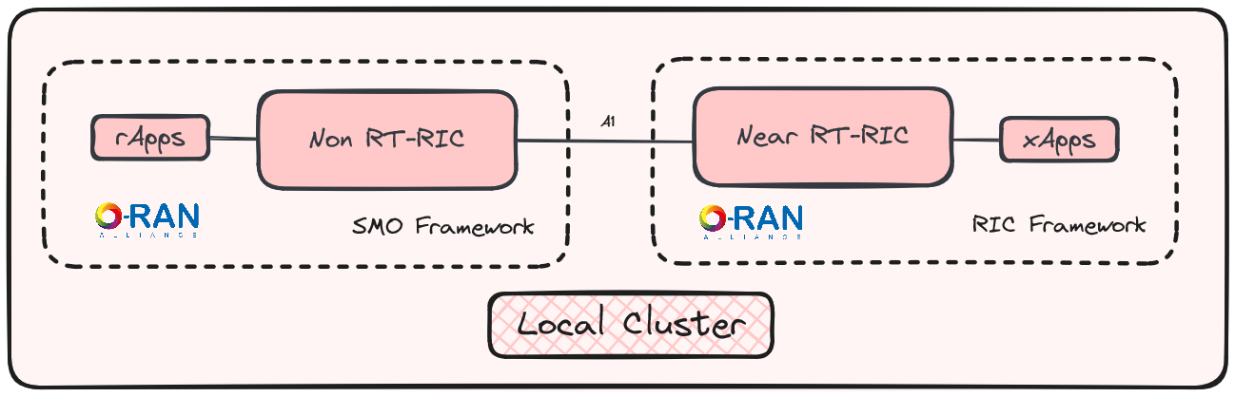
Current Research
Progress:
Continue to learn about O-RAN Specification Knowledge Base
Setup local cluster & Cloud VM for initial E2E and RIC workspace
Setup Non RT-RIC and basic operation
Troubleshoot for srsRAN project and Open5Gs Integration
Challenge:
O-RAN srsCU-srsDU customization 7.2x split option still not on the container format form to run
srsRU-Emu still not tested and integrated with srsDU and srsUE
Clocking Sync Integration with Linux PTP
Separated workspace due to limited computing resource

Slide 3
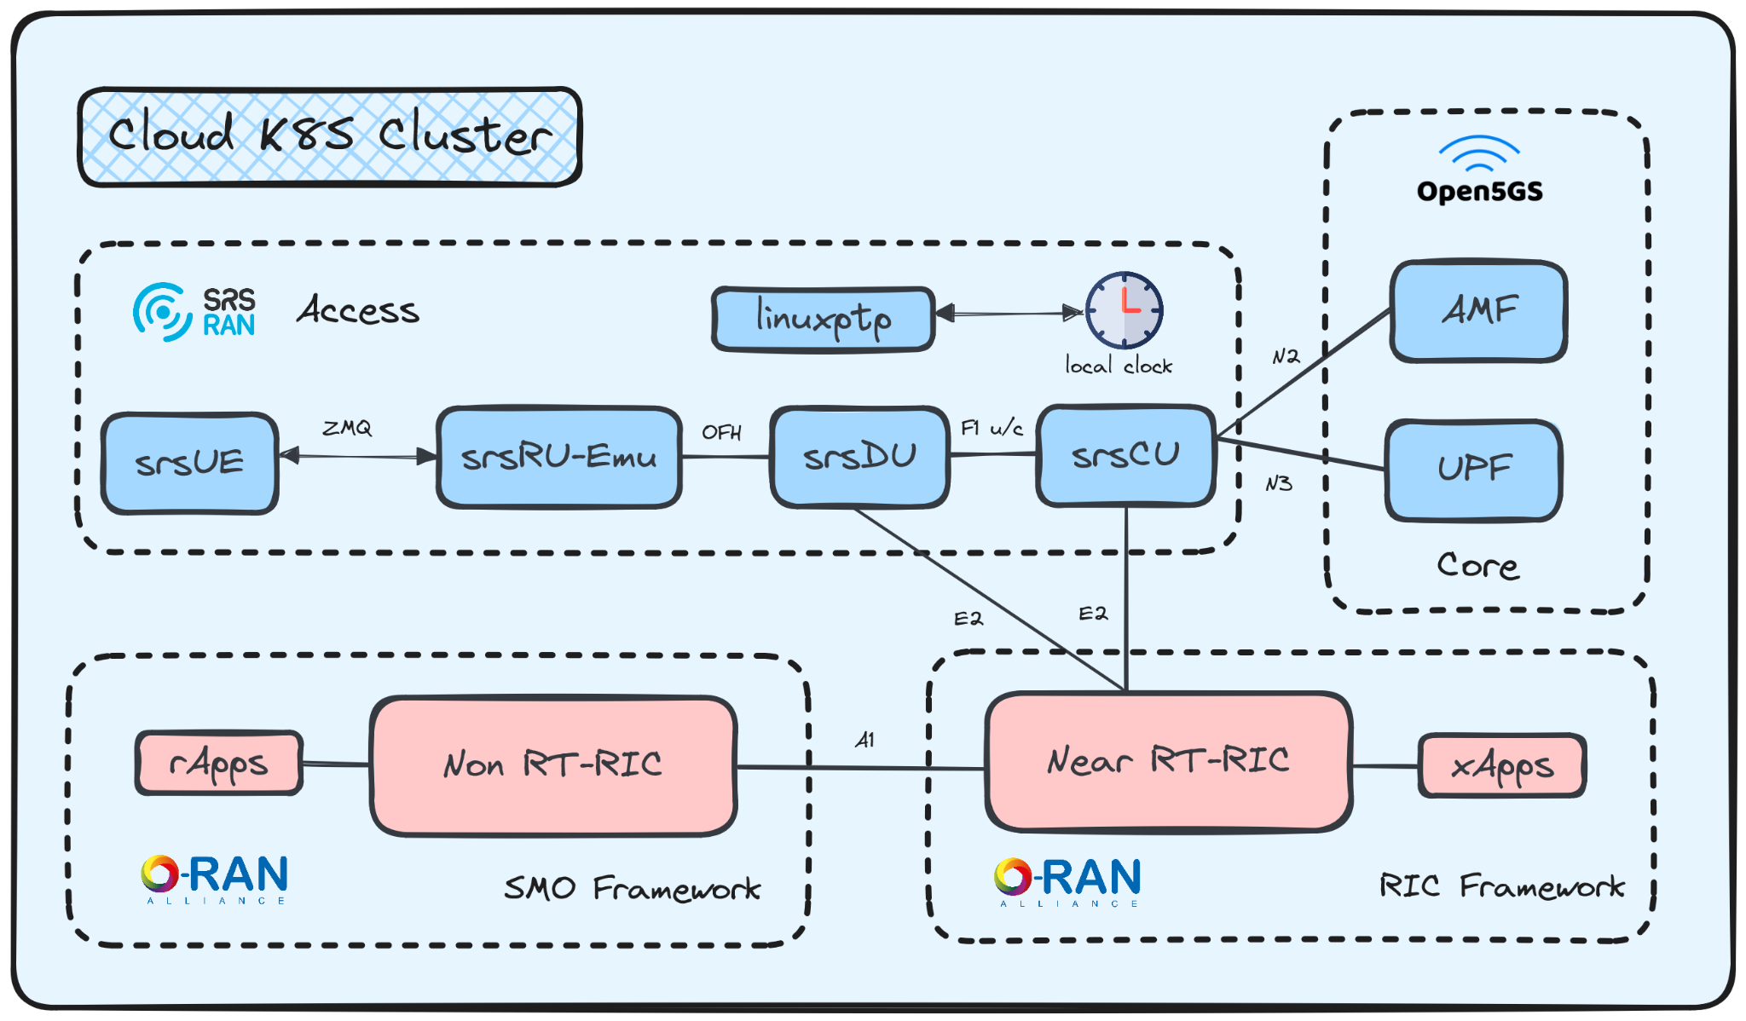
Future Research
Goals:
Deployed Customized O-RAN Components by srsRAN
Integration all on K8S Cluster
E2E Testing Success
Custom rApps Development
Remaks:
UPF Connection on Open 5Gs to srsRAN Project
Split 7.2x Option Analysis
E2 Integration Testing
RIC and SMO Framework needs to be on top

Slide 4
Future Research
Goals:
Deployed Customized O-RAN Components by srsRAN
Integration all on K8S Cluster
E2E Testing Success
Custom rApps Development
Remaks:
UPF Connection on Open 5Gs to srsRAN Project
Split 7.2x Option Analysis
E2 Integration Testing
RIC and SMO Framework needs to be on top

Slide 5
Reference
Install & Configure FlexRAN 5G NR L1 Application
O-RAN CU/DU customized by srsRAN
srsRAN 4G with ZMQ Virtual Radios
srsRAN gNB on Kubernetes
Simplified ORAN SC RIC with improved usability and xApp examples
Helm Chart for Open 5Gs
E2E Testing using srsRAN Environment

Slide 6
O-RAN srsRAN Solution Integration
TEEP 2024 - Midterm Progress
Presented by:
Rafli Hadiana
Telkom University Student

Slide 7
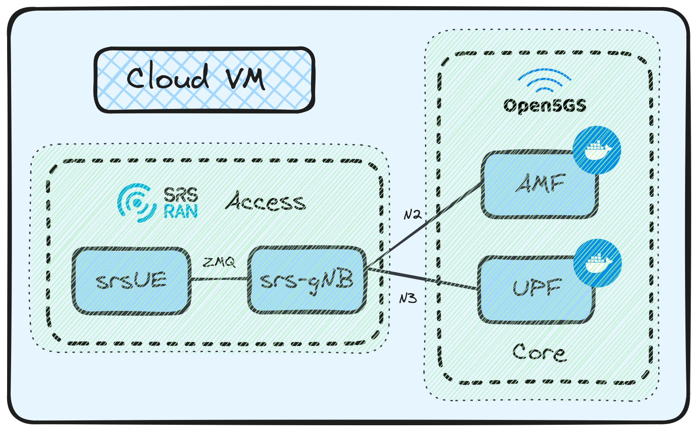
Current Progress
Playground 1 - srsRAN gNB to srsUE
Progress Checklist:
Setup Core Network ✅
Setup srs-gNB ✅
Setting srsUE ✅
srsUE Traffic Testing ✅
srsMulti-UE Setup ✅
Documentation:
https://hackmd.io/@raflihadiana/srsRAN#Playground-1--srsRAN-gNB-to-srsUE-on-VM

Slide 8
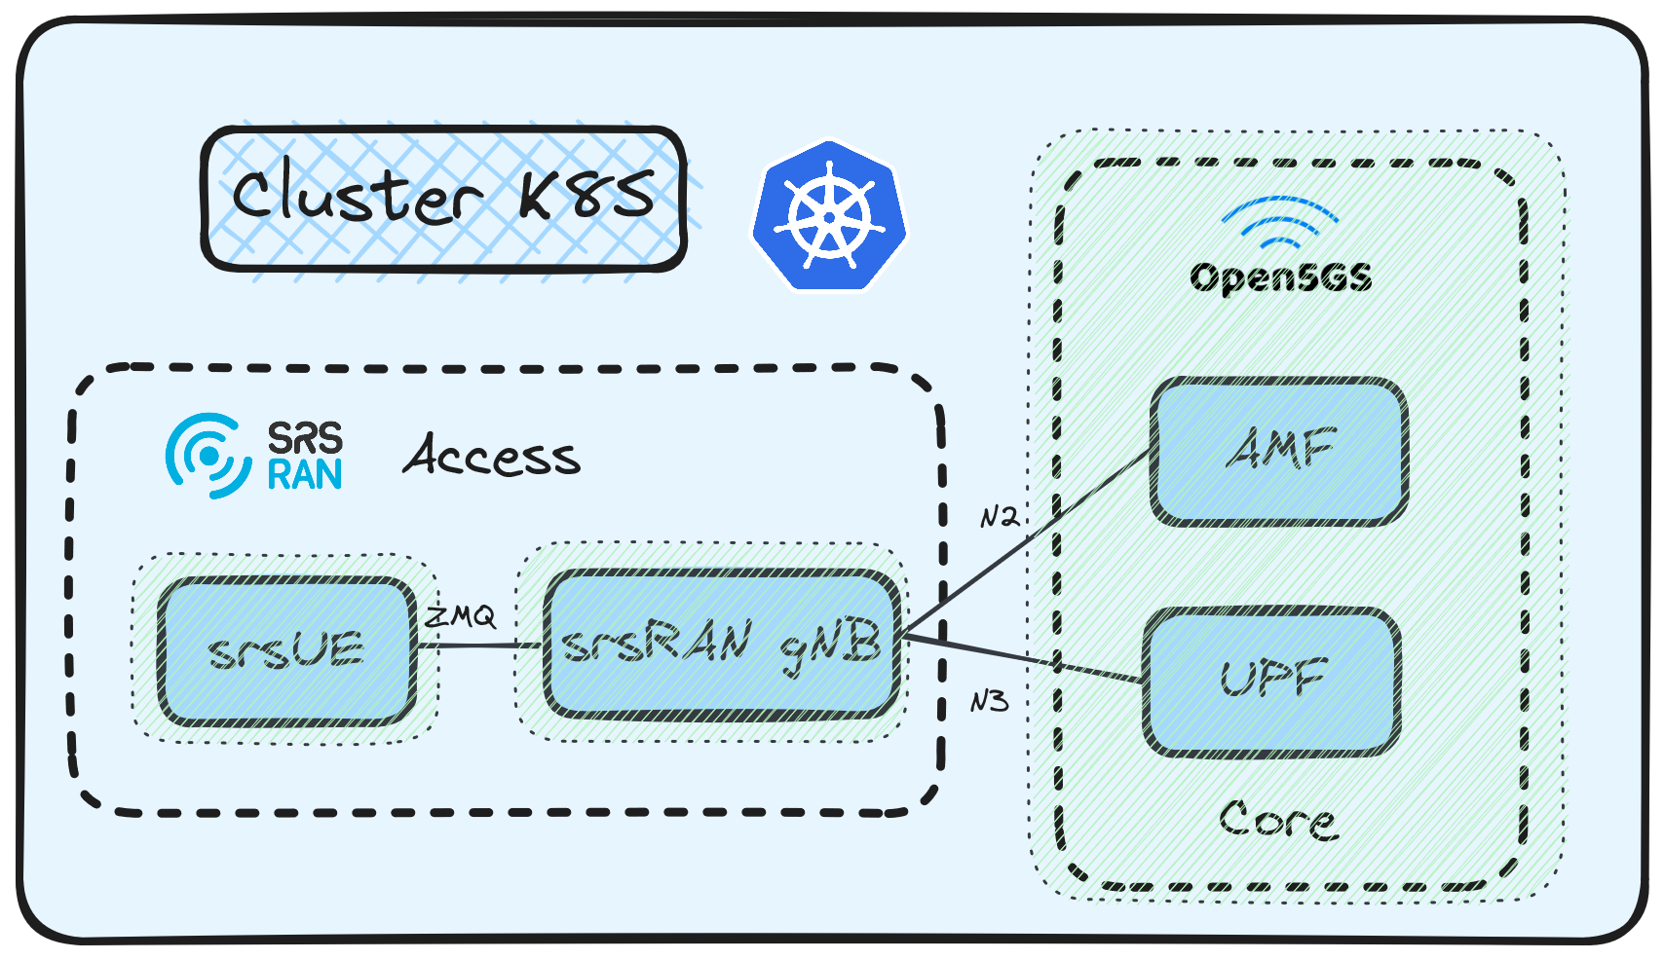
Current Progress
Playground 2 - srsRAN gNB on K8S
Progress Checklist:
Setup Core Network Pods ✅
Setup srs-gNB Pods ✅
Setting srsUE Pods ✅
srsUE Traffic Testing Pods ❌
Documentation:
https://hackmd.io/@raflihadiana/srsRAN#Playground-2--srsRAN-gNB-and-srsUE-on-K8S

Slide 9
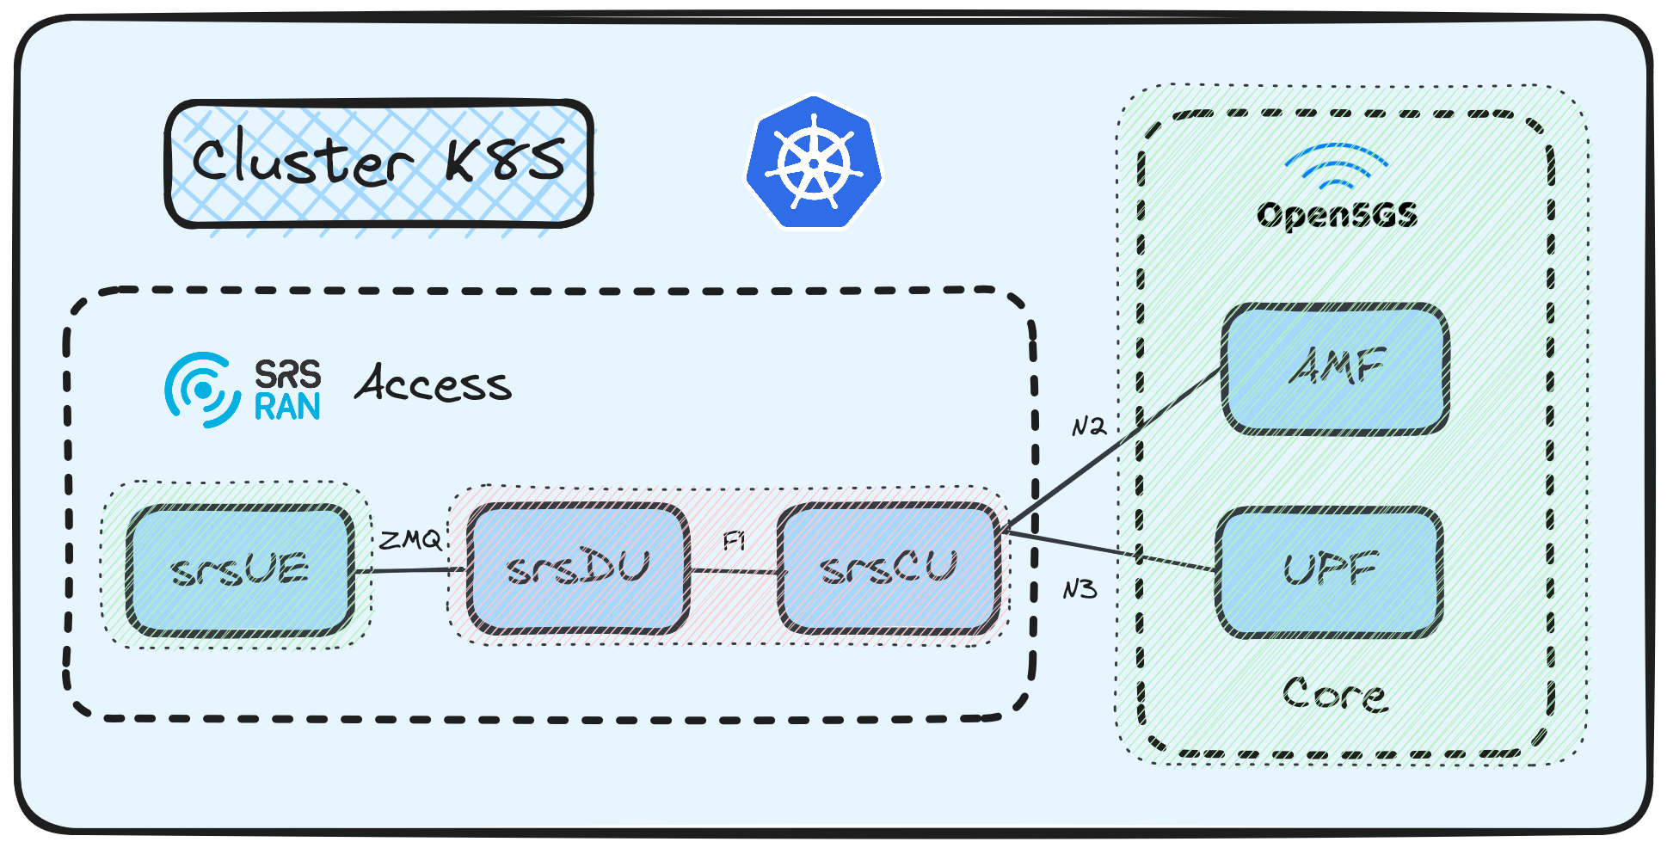
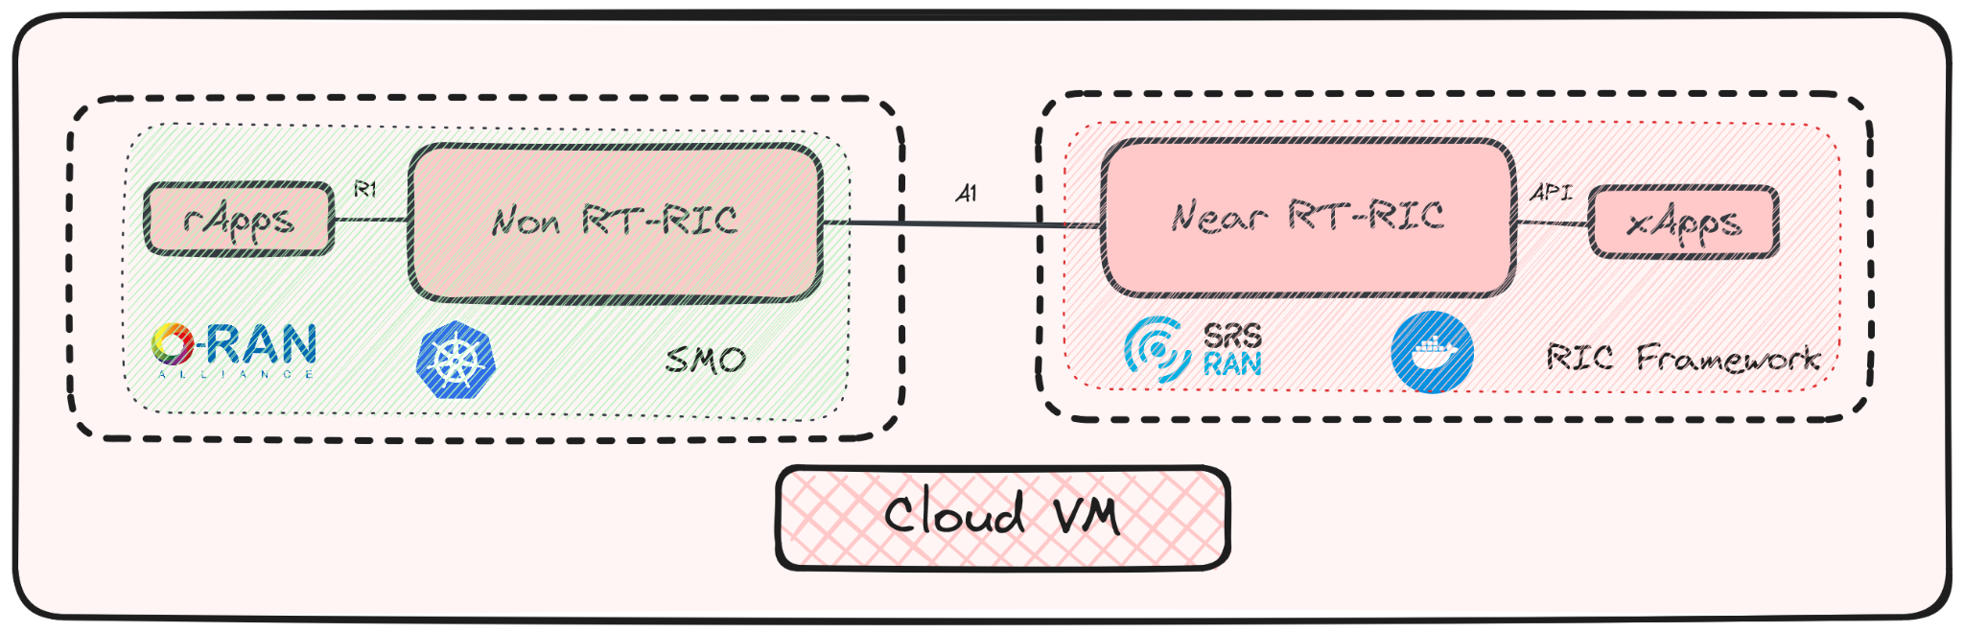
Problem Found
Playground 3 - srsRAN gNB Split 2 Implementation
Problem 3 Checklist:
Troubleshoot on compiling the srsDU-srsCU configuration values
Initialize srsDU-srsCU Docker Image
srsRU-Emu Needs Physical O-RU
Clocking Sync Integration with Linux PTP needs PTP Gradmaster
Playground 4 - srsRAN Near RT-RIC to setup E2
Problem 4 Checklist:
Setup Customized Near RT-RIC from Docker Compose setup to K8S

Slide 10
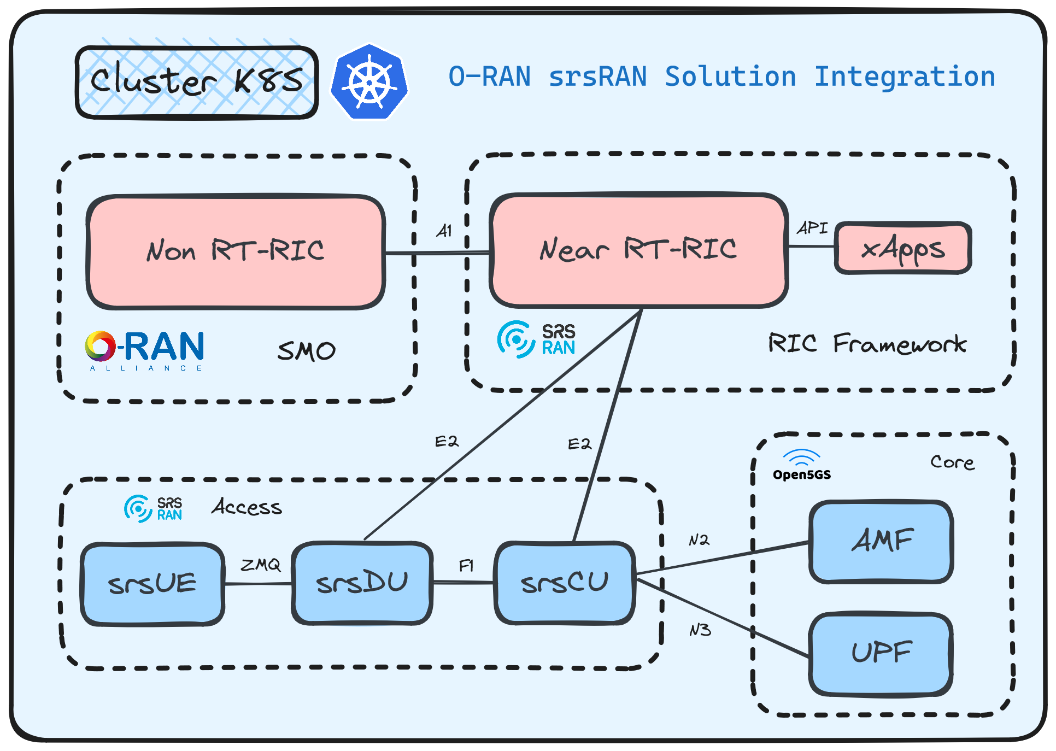
Final Target
Playground 5 - Overall Integration and Interface Ready
Progress Checklist:
Deployed Customized O-RAN Components by srsRAN
Integration all on K8S Cluster
E2E Testing Success
A1 and E2 Interface Ready (Except O1)
Github:
https://github.com/bmw-ece-ntust/internship/tree/2024-TEEP-18-Rafli

Slide 11
O-RAN srsRAN Solution Integration
TEEP 2024 - Final Review
Presented by:
Rafli Hadiana
Telkom University Student

Slide 12
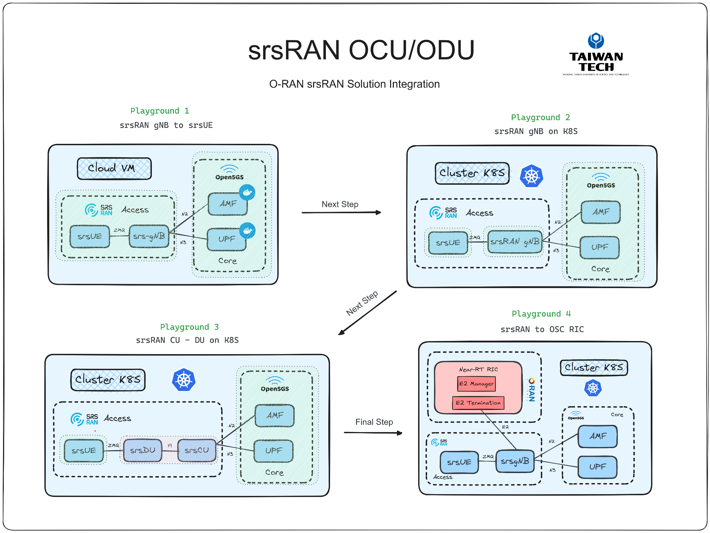
Research Journey
Lesson Learned:
If you want Implement srsRU-Emu, then it needs a physical O-RU
If you want to implement Clocking Sync Integration with Linux PTP It needs a physical switch as PTP Grandmaster
If you want to implement full simulation, ZMQ is the way
Contribution:
Initialize the creation of srs-DU & srs-CU Docker Image
Create a custom helm deployment for srsUE 4G, srs-DU, srs-CU and srs-gNB
Configuration E2 Ready

Slide 13
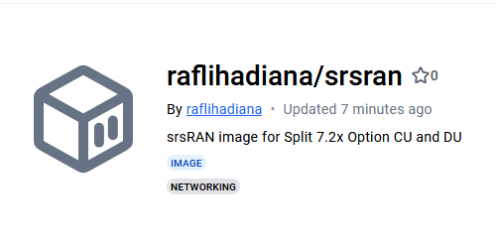
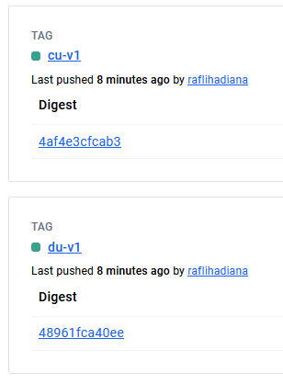
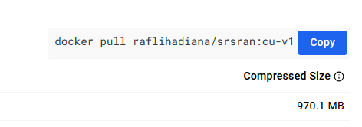
Research Contribution
Playground 3 - srsRAN gNB Split 2 Implementation
1. Dockerfile CU & DU Creation
# Use an official Ubuntu image as a base FROM ubuntu:20.04 # Set the environment variables to prevent interactive prompts during installation ENV DEBIAN_FRONTEND=noninteractive # Update and install necessary packages RUN apt-get update && apt-get install -y \ cmake \ make \ gcc \ g++ \ pkg-config \ libfftw3-dev \ libmbedtls-dev \ libsctp-dev \ libyaml-cpp-dev \ libgtest-dev \ libzmq3-dev \ git \ curl \ jq \ && rm -rf /var/lib/apt/lists/* # Clone the srsRAN_Project repository RUN git clone https://github.com/srsran/srsRAN_Project.git /opt/srsRAN_Project # Build srsRAN RUN cd /opt/srsRAN_Project && \ mkdir build && \ cd build && \ cmake ../ -DENABLE_EXPORT=ON -DENABLE_ZEROMQ=ON && \ make -j$(nproc) # Set the working directory to /apps/cu WORKDIR /apps/cu # Copy the built srscu binary to /usr/bin RUN cp /opt/srsRAN_Project/build/apps/cu/srscu /usr/bin/srscu # Define the command to run the srscu with the specified configuration file CMD ["srscu", "-c", "cu.yml"]
Research Gap:
1. There is no Docker images and Helm charts for srsRAN O-RAN CU-DU Split and mainly support basic deployments.

Slide 14
Research Contribution
Playground 3 - srsRAN gNB Split 2 Implementation
2. srs-gNB Helm Chart
4. srs-gNB Helm Configmap
apiVersion: v2 appVersion: 23.10.1 dependencies: - name: common repository: https://charts.bitnami.com/bitnami tags: - bitnami-common version: 1.x.x description: 'Helm chart to deploy srsRAN 5G gNB on Kubernetes. ' maintainers: - email: raflihadian24@gmail.com name: raflihadiana name: srsran-5g-zmq sources: - https://github.com/gradiant/5g-charts - https://github.com/srsran/srsRAN_Project version: 1.0.0
apiVersion: v1 kind: ConfigMap metadata: name: {{ include "common.names.fullname" . }}-entrypoint labels: {{- include "common.labels.standard" . | nindent 4 }} data: entrypoint.sh: | #!/bin/bash set -ex if [ $# -lt 1 ] then echo "Usage : $0 [gnb]" exit fi if [[ ! -z "$AMF_HOSTNAME" ]] ; then export AMF_ADDR="10.233.102.203" fi if [[ -z "${AMF_BIND_ADDR}" ]] ; then export AMF_BIND_ADDR=$(ip addr show $AMF_BIND_INTERFACE | grep -Po 'inet \K[\d.]+') fi envsubst < /gnb-template.yml > gnb.yml /opt/srsRAN_Project/target/bin/gnb -c gnb.yml
Research Gap:
2. Official Helm charts typically focus on single-component deployments, with limited customization for deploying integrated srsUE, srs-DU, srs-CU, and srs-gNB networks.
3. srs-UE Helm Chart
apiVersion: v2 appVersion: 23.10.1 dependencies: - name: common repository: https://charts.bitnami.com/bitnami tags: - bitnami-common version: 1.x.x description: 'Helm chart to deploy srs-ue on Kubernetes.' maintainers: - email: raflihadian24@gmail.com name: srs-ue sources: - https://github.com/gradiant/5g-charts - https://github.com/srsran/srsRAN_Project version: 1.0.0
5. Full Helm Repository
https://github.com/bmw-ece-ntust/internship/tree/2024-TEEP-18-Rafli/playground/03-srsran-split

Slide 15
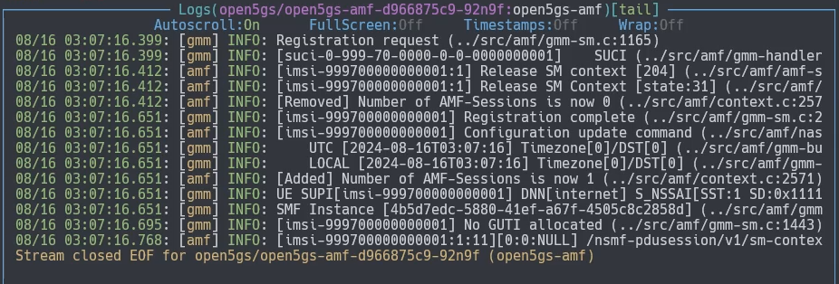
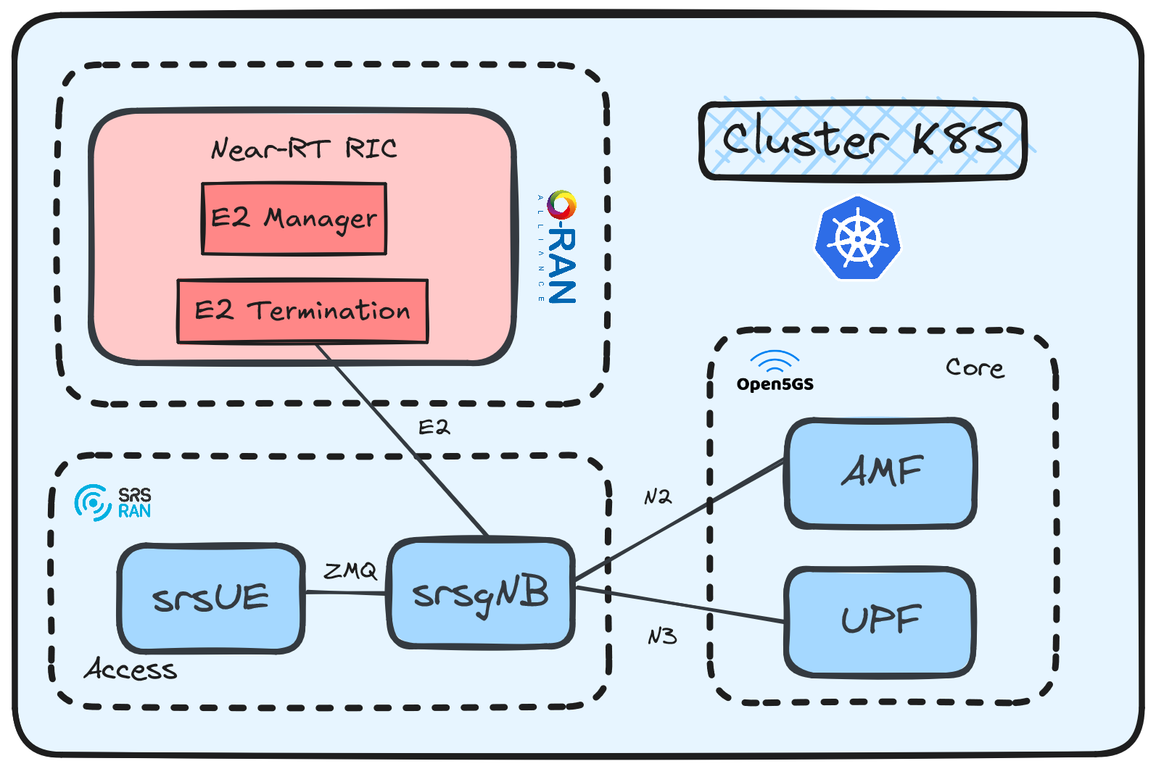
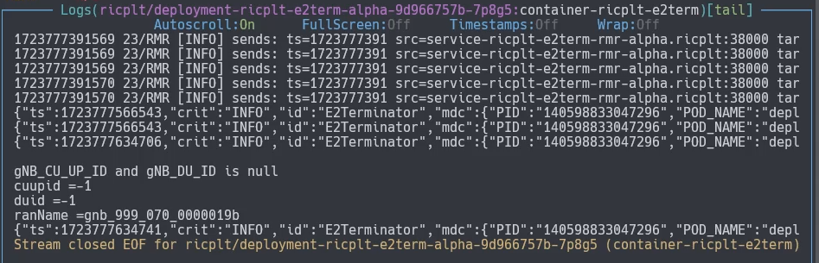
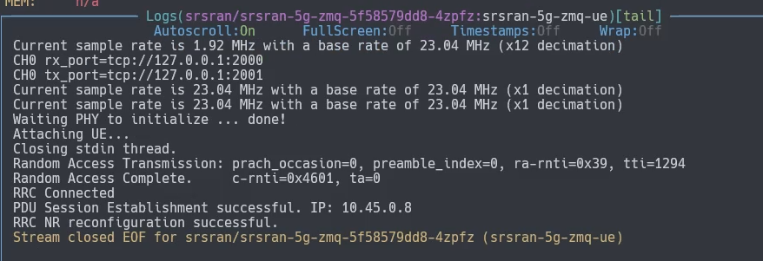
Research Journey
Playground 4 - srsRAN to OSC RIC
5. AMF - RIC - SRSRAN LOG
Accomplishment:
Create a Helm Customized O-RAN Components by srsRAN
Integration all on K8S Cluster
E2E Testing Success
E2 Interface Ready

